Slide 1
Endoscopic Scoring systems in Crohn’s : What we will cover…
Why do we need to use endoscopic scoring systems?
What makes an ideal scoring system?
Why do we need both local and central reading?
Interactive case presentation on the SES CD
Discussion on practical implications for the profile trial

Slide 2
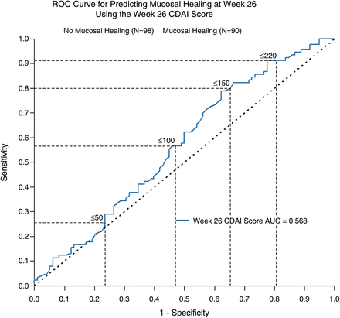
Endoscopic Scoring Systems in Crohn’s Disease: Why do we use endoscopic outcomes in research?
Clinical assessment of disease activity is often subjective
 | ‘Clinical Remission’ (CDAI <150, n= 136) | ‘Moderate-Severely Active CD’ (CDAI ≥220)
Complete Mucosal Healing | 56.9% | 29.6%
CRP Normalization | 64.7% | 48.2%
Both, Complete Mucosal Healing and CRP Normalization | 39.7% | 22.9%
Peyrin-Biroulet L ,et al. Gut. 2014 Jan;63(1):88-95. doi: 10.1136/gutjnl-2013-304984

Slide 3
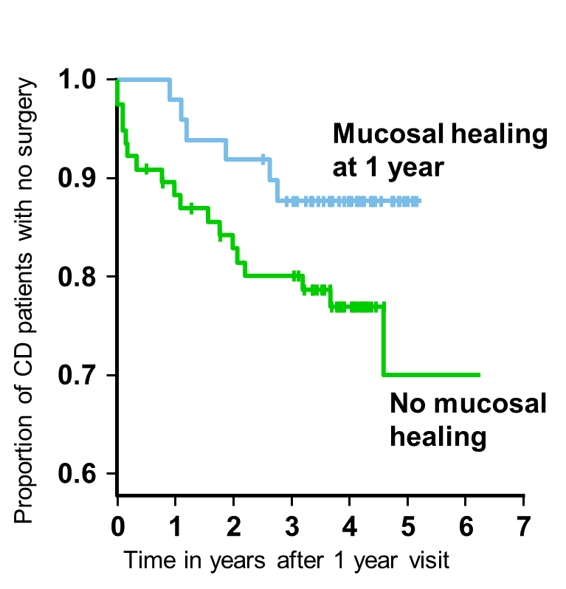
Endoscopic Scoring Systems in Crohn’s Disease: Why do we use endoscopic outcomes in research??
Endoscopic assessment of mucosal healing can predict disease course
IBSEN group: 227 incident CD
assessed at 1 and 5 years
SUTD: infliximab induced mucosal healing and long-term remission
Clinical remission (CDAI <150, no steroids, no
100
resections) through year 3+4
80
p=0.036
69.6
60
% of patients
38.1
40
20
0
16/23
8/21
Mucosal healing (SES=0 at year 2)
CD, Crohn’s disease; SES, Simple Endoscopic Score.
1. Froslie KS. Gastroenterology 2007;133:412–22; 2. Colombel JF, et al. Gastroenterology 2011;141:1194–201;
Endoscopic activity (SES=1–9 at year 2)

Slide 4
Endoscopic Scoring Systems in Crohn’s Disease: Why do we use endoscopic outcomes in research??
Endoscopic assessment of mucosal healing can predict response to therapy

Slide 5
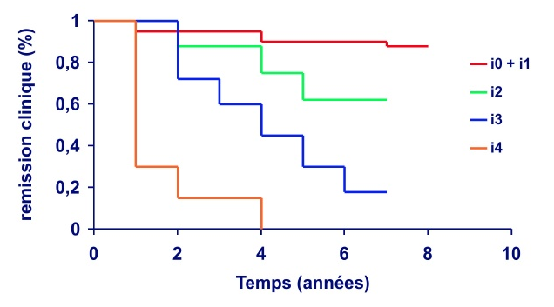
Endoscopic Scoring Systems in Crohn’s Disease: Why do we use endoscopic outcomes in research??
Endoscopic assessment of mucosa can predict disease recurrence post surgery
Clinical Relapse According to Initial Endoscopic Score
Clinical remission (%)
Time (years)
Rutgeerts et al, Gastroenterology 1990;99:956

Slide 6
Scoring Systems in Endoscopy: Why do we need to use endoscopic scoring systems?
Assessment of endoscopic activity is gold standard in clinical trials and is an FDA required outcome for trials in Crohn’s disease
Primary endpoint
Week 48 data for CALM trial
p=0.010
p=0.014
Patients (%)
p=0.006
56
37
45
28
36
19
CDAI <150; no steroids for 8 weeks; no draining fistula;
CDEIS <4; no deep ulcers
Calprotectin <250 µg/g; CRP <5 mg/L; CDEIS <4
Colombel JF, et al. Presented at Digestive Disease Week, 6–9 May 2017, Chicago, IL: Abstract 718.
CDAI, Crohn’s Disease Activity Index; CDEIS, Crohn’s Disease Endoscopic Index of Severity.

Slide 7
Scoring Systems in Endoscopy: Why do we need to use endoscopic scoring systems?
Accurate reporting of endoscopic findings are essential for patient management
17 year male with ileo-colonic Crohn’s disease
Steroids at index flare, refractory to appropriately dosed azathioprine
Colonoscopy at that stage showed aphthoid ulceration in the rectum, deep circumferential ulceration in the sigmoid colon and scattered deep ulcers in the terminal ileum.
Commenced Infliximab 5mg/kg induction and maintenance with symptomatic and biochemical remission
Secondary loss of response with abdominal pain, bloating and weight loss, find it difficult to pass stool
CRP 8mg/l
IFX drug levels are 10 μg/g with no ADA
Previewed in the virtual biologics MDT
? Ongoing inflammation versus stricture
Surgery vs switch biologic class
Organize colonoscopy

Slide 8
Scoring Systems in Endoscopy: Why do we need to use endoscopic scoring systems?
Accurate reporting of endoscopic findings are essential for patient management

Slide 9
Scoring Systems in Endoscopy: What makes an ideal scoring system?
Practical to use in routine clinical endoscopy and clinical trials
It must have VALIDITY (the extent to which a measurement actually measures what it purports to measure)
Content Validity (does the instrument measure appropriate items)
Construct validity (does it correlate with other measures of disease activity)
Concurrent validity (compared to gold standard)
It must have RELIABILITY (the extent to which repeated measurements yield consistent result)
Inter rater reliability (two different people)
Intra rater reliability (one person at different times)

Slide 10
Scoring Systems in Endoscopy: What makes an ideal scoring system?
Baron Score in UC: Expert Panel vs Central Reader

Slide 11
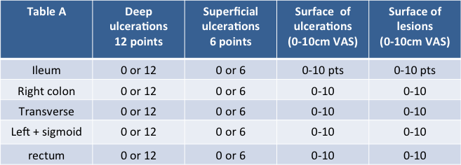
Endoscopic Scoring Systems in Crohn’s disease: What are the currently available tools?
Crohn’s Disease Endoscopic Index of Severity (CDEIS)
Mary et al, GETAID, Gut 1989

Slide 12
Endoscopic Scoring Systems in Crohn’s disease: What are the currently available tools?
Simple Endoscopic Score in Crohn’s Disease (SES-CD)
Variable | 0 | 1 | 2 | 3
Size of ulcers (cm) | None | Aphthous ulcers (0.1-0.5cm) | Large ulcers (0.5-2cm) | Very large ulcers (>2cm)
Ulcerated surface (%) | None | <10 | 10-30 | >30
Affected surface (%) | 0 | <50 | 50-75 | >75
Presence of narrowings | None | Single, passable | Multiple, passable | Impassable
SES-CD SUM TOTAL |  |  |  | 0-56
“substantial” to “almost perfect” intra- and inter-observer reliability (intraobserver ICC, 0.91; 95% CI 0.87–0.94 and interobserver ICC, 0.83; 95% CI, 0.75–0.89)
Excellent correlation with CDEIS (Spearman’s r = 0.920)
Recently independenly confirmed (Spearman's r = 0.938)*
Daperno et al, GI Endoscopy 2004;60:505-12, *Sipponen et al, IBD 2010;16:2131-6

Slide 13
Endoscopic Scoring Systems in Crohn’s disease: What are the currently available tools?
Simple Endoscopic Score in Crohn’s Disease (SES-CD)
Variable | Ulcer Size (0-3) | Ulcerated Surface (0-3) | Affected Surface (0-3) | Narrowing (0-3) | TOTAL
Ileum
Caecum / Ascending
Transverse
Descending/ Sigmoid
Rectum
TOTAL SES CD

Slide 14
Endoscopic Scoring Systems in Crohn’s disease: What are the currently available tools?
MAIN ISSUES:
interpretation of superficial ulceration, defining location of ulcers involving two contiguous segments, differentiating between anal and rectal lesions and grading severity of stenosis
Khanna R et al Gut. 2016 Jul;65(7):1119-25.

Slide 15
Scoring Systems in Endoscopy: Interactive voting case presentation
Simple Endoscopic Score in Crohn’s Disease (SES-CD)

Slide 16
Scoring Systems in Endoscopy: What are the currently available tools?
Rutgeerts Score of post operative Crohn’s disease recurrence
Endoscopic findings Score
No aphthous ulcers (normal) 0
Less than five aphthous ulcers 1
More than five aphthous lesions with normal intervening mucosa, 2
or lesions confined to ileocolonic anastomosis (ie, less than 1 cm in length)
Diffuse aphthous ileitis with diffusely inflamed mucosa 3
Diffuse inflammation with larger ulcers, nodules and/or narrowing 4

Slide 17
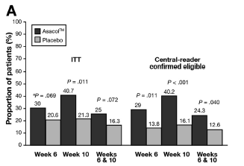
Endoscopic Scoring Systems in Crohn’s disease: Why bother with central reading?
Inclusion bias: investigators may inflate scores to ensure a patient is included
Outcome bias: investigators may reduce scores as they want their patient to get better
Trial of Asacol™ 800mg vs placebo - Primary outcome remission at wk6
31% of subjects with UCDAI endo score >2 as judged by endoscopist were deemed ineligible by central reader
Feagan et al. Gastroenterology 2013

Slide 18
Endoscopic Scoring Systems in Crohn’s disease: OK then, so why bother with local reading?
Practicality around recording videos for Profile (and ASTIClite)
PLEASE do not forget to remove patient Identifiable data prior to recording (no name, no DOB, no hospital number)
Record extubation only
Wash mucosa and remove excess fluid on intubation if possible
Record time that you enter each segment (ideally from time stamp on monitor /or time of video
Pause video when taking biopsies
Pause around areas of inflammation – wash if superficial
Take care not to skip past areas and do make an obvious attempt to enter strictured areas

