Slide 1


Slide 2



SLE
ANCA-associated vasculitis
Multiple sclerosis
Rheumatoid arthritis
Crohn’s Disease
Ulcerative colitis
etc.
Diagnosis
Quiescent disease
Good outcome
Prognosis
Relapsing or persistent disease
Disability or death

Slide 3


Transcriptomics and long-term outcome in immune-mediated disease
array
0
6
12
time / months
CD16⁺
patients with active, untreated disease
purified cell subsets source of mRNA
detailed prospective long term clinical phenotyping
ANCA-associated vasculitis, SLE, Crohn’s disease, Ulcerative Colitis

Slide 4

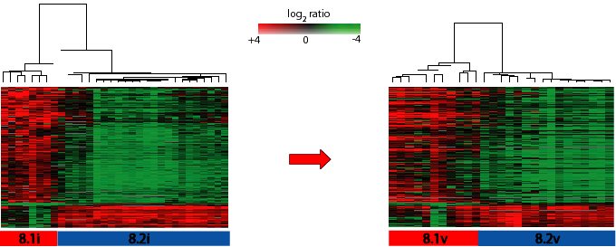
CD8 T cell expression profiling defines ANCA-associated vasculitis subgroups
Initial Cohort
n = 32
Validation Cohort
n = 28
McKinney et al. Nature Medicine 2010

Slide 5
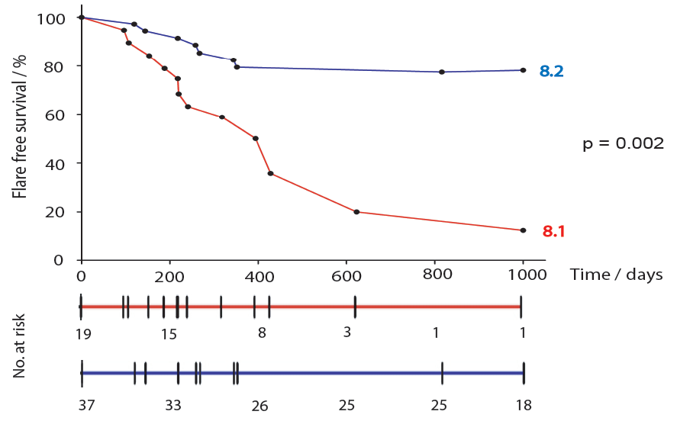
CD8 signature predicts outcome in ANCA-associated Vasculitis
Time to disease flare
8.2
8.1
McKinney et al. Nature Medicine 2010

Slide 6
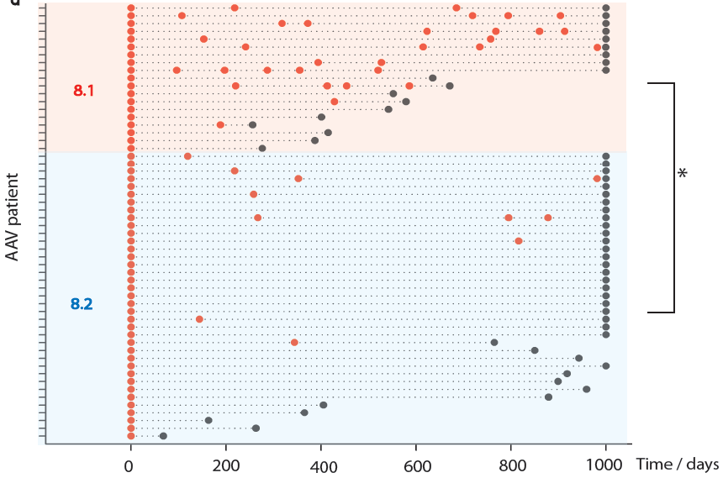
Increased flare rate in subgroup 8.1
Flare rate normalised to follow-up duration p = 0.01

Slide 7
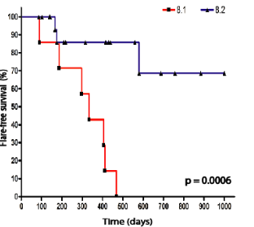

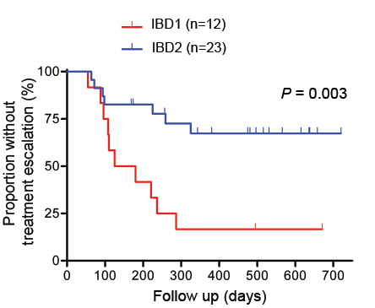
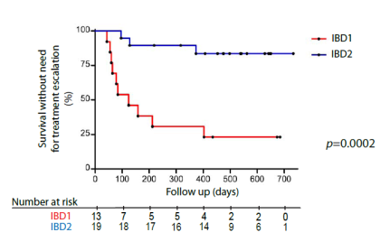
Crohn’s disease
Systemic Lupus Erythematosus
Ulcerative
Colitis
Survival without need for treatment escalation
Lee et al. JCI 2011
Signature confirmed in SLE in Singapore (Flint et al. RMD Open, 2016)

Slide 8
Prognostic signature, or surrogate, predicts
  good outcome in infection (HIV, HCV) and vaccination (Malaria, Yellow Fever, Influenza)
  poor outcome in autoimmunity (AAV, SLE, IBD, T1D, IPF…).
NOT apparent when disease is quiescent – inflammation appears required
Association with prognosis, NOT disease activity or response to initial treatment
Similar proportions in different diseases/ vaccines
Appears independent of antigenic stimulus (vaccine induces same signature as disease in an individual)

Slide 9
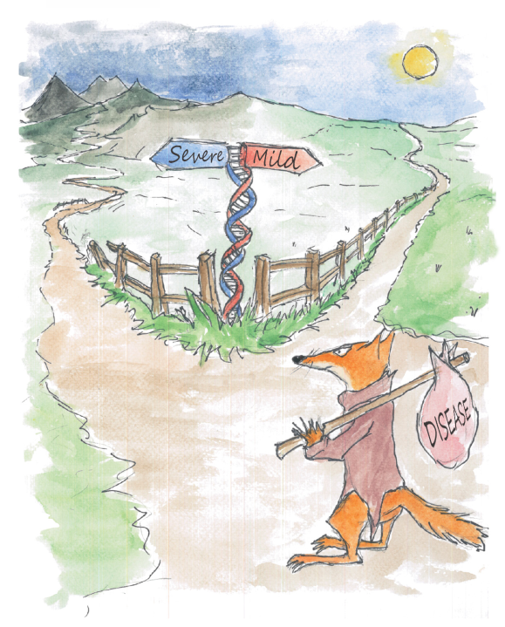
Do common variants control outcome independent of diagnosis?
John Sowerby
(apologies to Quentin Blake)

Slide 10
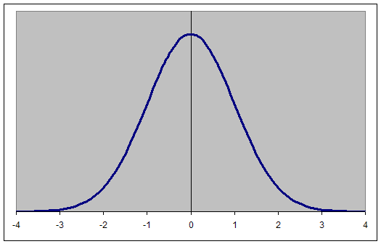
Crohn’s candidate gene analysis by outcome
~1800 CD patients
Disease behaviour
“Flarers” (n = 668)
> 2 immunomodulators
OR
> 2 abdominal operations
OR
Immunomodulator + an operation
“Fizzlers” (n = 389)
No immunomodulators
AND
No surgery
AND
> 4 years follow up
81 genes curated on basis of “red” signature
WTCCC 2006 Nature

Slide 11
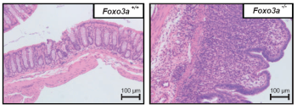
FOXO3A variant (G allele)
associated with mild course
- 4 cohorts
- genome-wide significance
NOT associated with CD
susceptibility
G/G (Milder Crohn’s)
Increases FOXO3 transcription
upon monocyte activation
FOXO3^{-/-} mice; worse DSS colitis
Faster recovery of nuclear FOXO3
Indirect
Increased
apoptosis
Direct binding to TGFβ1 promoter
Also associated with:
mild rheumatoid arthritis
severe malaria
Increased TGFβ1
Reduced TNFα, IL-6, IL-8, IL-1β, increased IL10 by monocytes
Increased IL10
Lee Cell 2013

Slide 12
Genome-wide Analysis of Prognosis in CD
~2600 CD patients
“Flarers”
> 2 immunomodulators
OR
> 2 abdominal operations
OR
Immunomodulator + an operation
“Fizzlers”
No immunomodulators
AND
No surgery
AND
> 4 years follow up

Slide 13


Primary cohort
669 aggressive CD
389 mild CD
Replication cohort
1093 aggressive CD
583 mild CD
UK Biobank Axiom arrays (Affymetrix)
Standard GWAS analysis

Slide 14
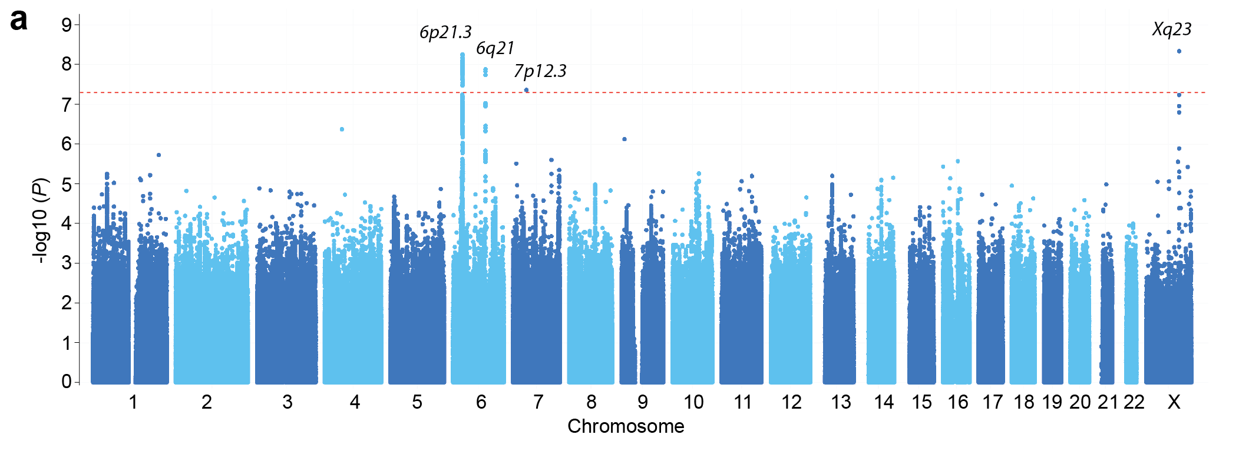
Lee, Biasci Nature Genetics 2017

Slide 15
Lee, Biasci Nature Genetics 2017
Notes:
Crohn's disease prognosis SNPs that met genome-wide significance (P < 5 × 10⁻⁸) in the combined analysis and nominal significance (P < 0.05) in both individual cohorts.
The odds ratio is presented with respect to the minor allele and the risk of poor prognosis CD. Allele frequency data is presented for the good prognosis CD cohort.
ª AG deletion
^{b} Insertion
^{c} rs75764599 could not be imputed in cohort 1 because of low linkage disequilibrium at this locus, and was therefore directly genotyped using a TaqMan SNP genotyping assay.
Chr, Chromosome; RAF, Risk Allele Frequency; ind., Indolent (good prognosis) CD; OR, odds ratio; 95% CI, 95% confidence interval for OR.

Slide 16
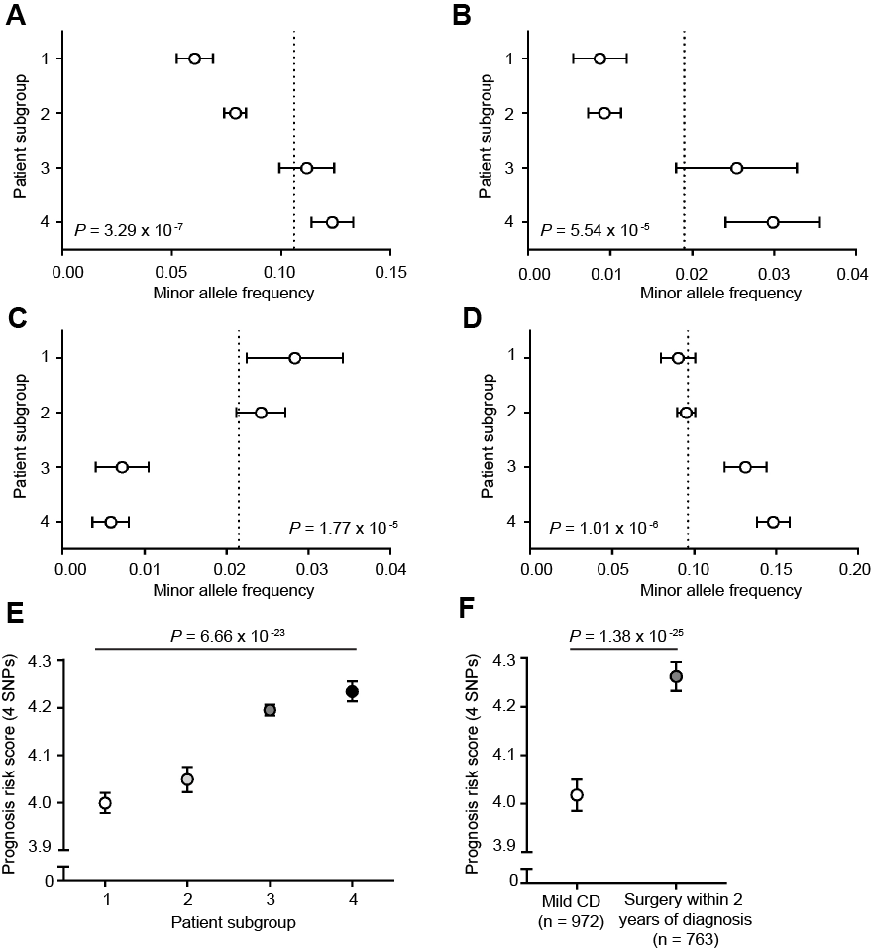
Associations persist with different definitions of outcome

Slide 17
MHC
MHC initially reported with UC not Crohn’s
High-density mapping has revealed a weak association between CD susceptibility and DRB1*0301

Slide 18
MHC

Slide 19
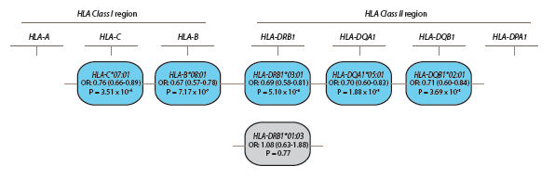
HLA
“Ancestral MHC 8.1” haplotype
James Traherne

Slide 20
“Ancestral MHC 8.1” haplotype
Unusually extended MHC haplotype
  2nd longest haplotype in human genome
  4,731,878 bases, 250 coding loci
Common (10-15% in Europeans)
Pre-neolithic expansion by positive selection (no wheat)
Reduced T cell activation to PHA
Reduced T cell activation markers ex vivo
Reduced response to Hep B vaccination
Component genes associated with many autoimmune diseases
C4 null

Slide 21
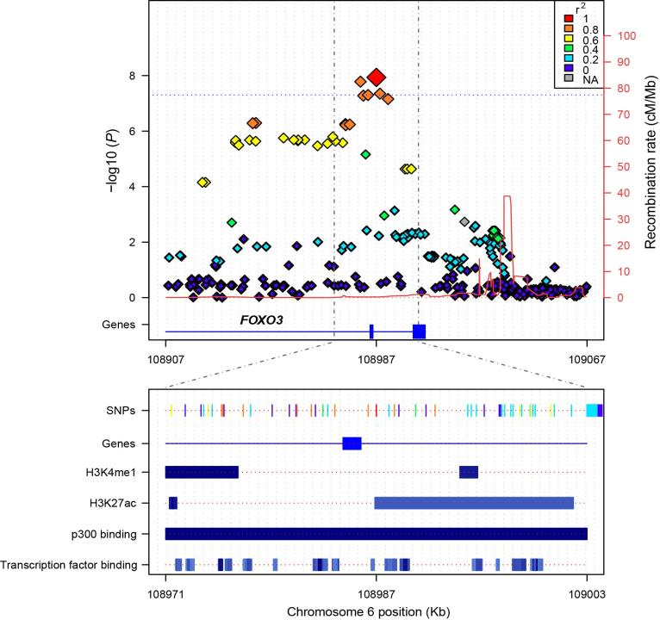
FOXO3A

Slide 22
XACT
Expressed from the active
X chromosome
Studied in pluripotent stem cells
How might it link to CD?

Slide 23
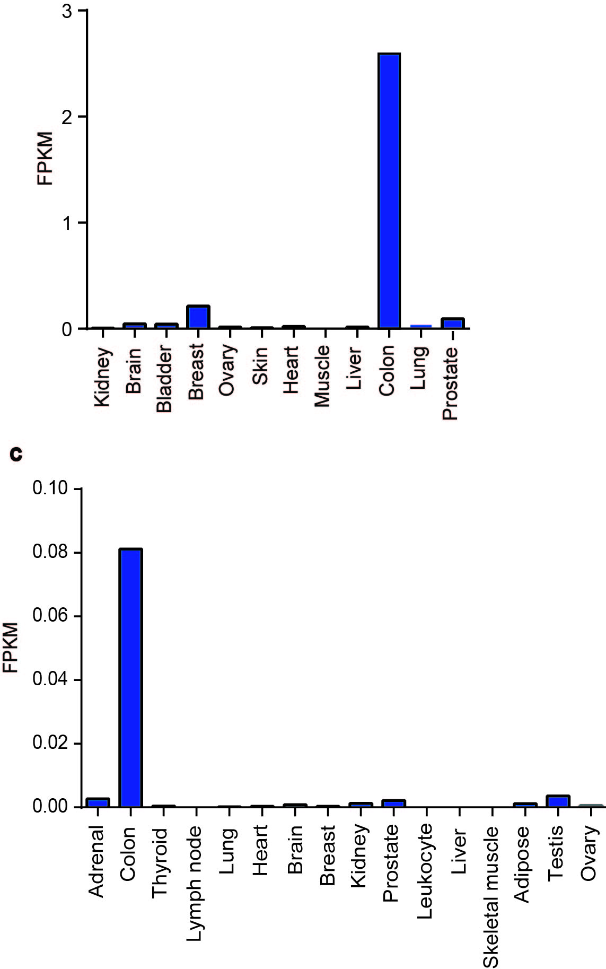
XACT

Slide 24
IGFBP1 / 3
Prolongs t_{1/2} of IGFI and II
IGF system impacts on immunity and inflammation
Locus associated with ACPA
ACPA predict poor outcome in RA

Slide 25
Prognosis-associated SNPs not associated
with CD susceptibility
International IBD Genetics Consortium meta-analysis
(5956 cases, 14,927 controls)

Slide 26
Susceptibility -associated SNPs not associated with CD prognosis.
None of 170 Crohn's alleles associated with prognosis.
even with liberal Bonferroni
after stratifying for disease location

Slide 27
A Genome-wide Analysis of Prognosis in CD
4 variants genome-wide
All plausible candidates, 3 implicated in other diseases
do not associate with susceptibility
Top 170 CD susceptibility variants together do not associate with prognosis
Genetically controlled common pathways drive outcome independent of susceptibility
Lee, Biasci Nature Genetics 2017

Slide 28
Distinct pathways govern susceptibility and patient outcome in autoimmune and inflammatory disease.
Associates with prognosis | Prognostic signature | MS signature | IBD Prognosis genetics
…in different diseases/states | +++ | ++ | ++
…and not disease activity | +++ | ++ | not tested
…and not susceptibility | circumstantial | not tested | +++

Slide 29
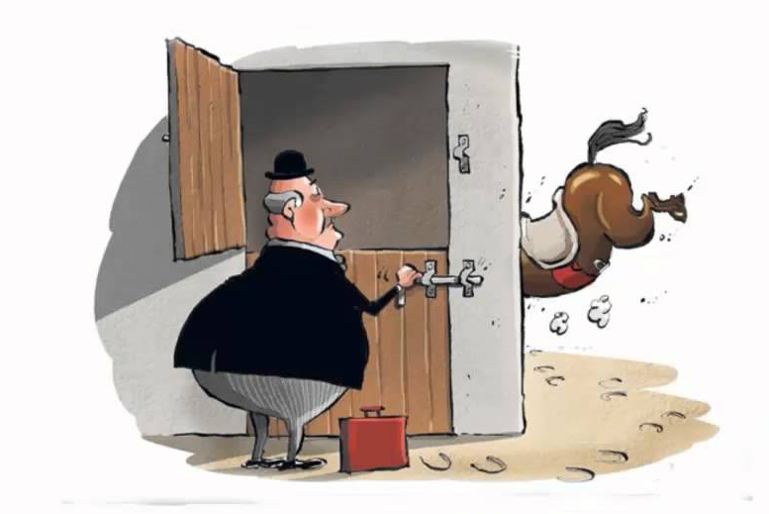
Disease course
GWAS
Susceptibility
GWAS

Slide 30





Paul Lyons
James Lee
Daniele Biasci
Eoin McKinney
James Peters
Marion Espéli
Limy Wong
Arianne Richard
Shaun Flint
James Traherne
Patients and
volunteers
Vasculitis and SLE Service
David Jayne and team
Addenbrooke’s Gastroenterology
Miles Parkes and team
Genetic Cohorts
UK IBD Genetics Consortium
Carl Anderson, Richard Gearry,
Rebecca Roberts, John Mansfield,
Tariq Ahmad, Natalie Prescott,
Jack Satsangi, David Wilson

Slide 31


Mechanism underlying
the prognostic signature
Developing and validating
a practical test in IBD
Delivering the test(s) to patients

Slide 32


