Slide 1
PROFILE - Trial Design
A randomised, multi-centre, biomarker-stratified open-label trial in patients newly diagnosed with Crohn’s disease.

Slide 2
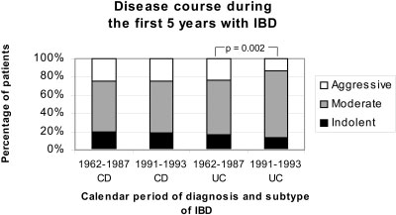
Issue
Clinical course / prognosis varies ++
between Crohn’s patients
Often greater impact on patients’
lives than the diagnosis of CD itself
Jess et al IBD 2007

Slide 3
Variable disease course....
43 %
19 %
3 %
32 %
Solberg et al. Clin Gastroenterol Hepatol 2007
Notes:
Nicely illustrates variability of dis course as seen in the IBSEN study - a

Slide 4
PROFILE - Recruitment
First participant recruited – December 2017
Overall Target – 400 participants over 2 years at approximately 40 to 50 sites
Site target recruitment is 5 per year i.e. one recruited participant every 2/3months

Slide 5
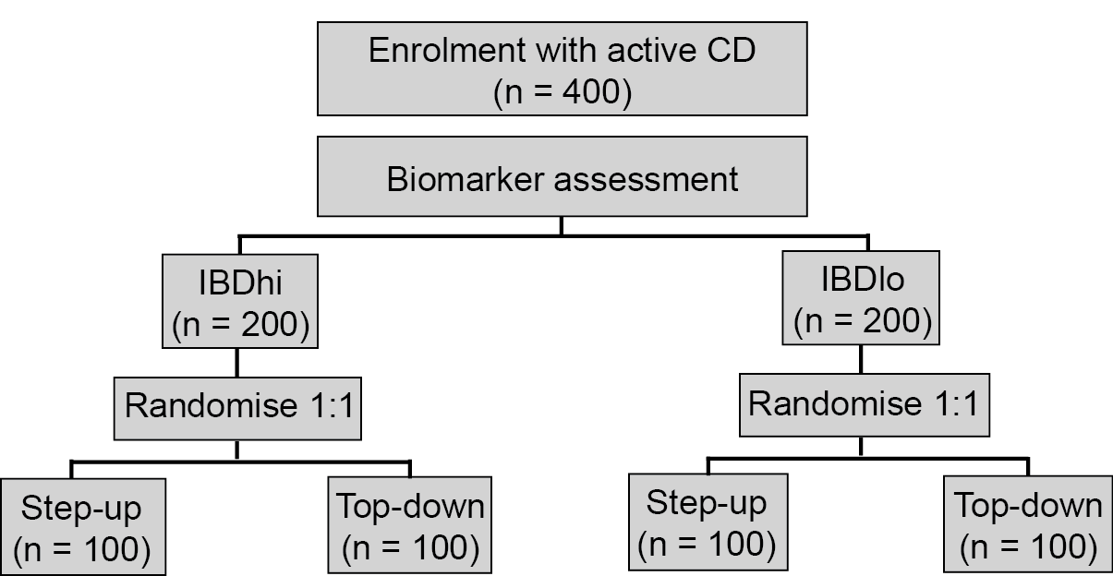
PROFILE - Schema

Slide 6
PROFILE – Outcome
Primary
Sustained surgery and steroid free remission from completion of steroid induction treatment through to week 48.
Secondary
Mucosal healing
Quality of life assessment (IBDQ)
i) Number of flares
ii) Cumulative steroid exposure
iii) Steroid-free remission
iv) Number of hospital admissions and operations

Slide 7
PROFILE- Inclusion/Exclusion
Inclusion Criteria:
Crohn’s disease diagnosed within 6 months* using standard endoscopic, histologic or radiological criteria.**
Clinical evidence of active Crohn’s disease, corresponding to an HBI > 7. (N.B. can be from prior two weeks to screening)
Endoscopic evidence of at least moderately active Crohn’s disease
CRP > upper limit of normal on local assay OR Calprotectin > 200 μg/g.
Immunomodulator and anti-TNFα naïve.
Aged 16-80 years old.
* Patients with newly-diagnosed patchy colonic inflammation, initially diagnosed as indeterminate colitis, would meet inclusion criteria for the trial if felt to be consistent with Crohn’s disease.
** Patients need to have discontinued systemic corticosteroids for one week or more prior to screening assessments and still have on-going, active disease.

Slide 8
PROFILE - Inclusion/Exclusion
- Exclusion Criteria:
Patients with ulcerative colitis
Patients with fistulating peri-anal Crohn’s disease or active perianal sepsis.
Patients with obstructive symptoms AND evidence of a fixed stricture on radiology or colonoscopy, which suggest that the subject is at high risk of requiring surgery over the following year. N.B. patients with modest degrees of stricturing on imaging but no obstructive symptoms may be included according to clinician judgement.

Slide 9
PROFILE - Inclusion/Exclusion
- Exclusion Criteria continued
Patients with contra-indications to study medications including a history of hepatitis B or C, tuberculosis.
Patients with a active malignancy.
Patients who are pregnant or breastfeeding at screening.
Other serious medical or psychiatric illness currently on going, or experienced in the last 3 months, that could compromise the study.
Patients unable to comply with protocol requirements (for reasons including alcohol and/or recreational drug abuse).

Slide 10
Patient pathway
Ideal scenario
Clinic -Screening: consent, samples and start steroids
Endoscopy (recorded)
Referral
Clinic
Identified as
potential for PROFILE
Study mentioned
to patient
Diagnosis conf /
Pt given info sheet
Pragmatic (real-world) scenario
Endoscopy
If flare within 6 months
=>Screenconsent, sample and start steroids
PROFILE trial
Referral
Steroids started
Clinic

Slide 11
PROFILE - Screening
Patient data to collect
Gender.
Date of birth.
HBI.
Height & Weight.
Results and images of colonoscopy performed within 6 months of the baseline screening assessment visit (including video-recording of procedure where possible).
Results and images of MRE if performed within 3 months of screening visit (pre or post (week16)).
IBDQ & EQ-5D, patient rated quality of life measures.

Slide 12
PROFILE - Screening
Samples to be collected and processed locally
Results of hepatitis B & C and Varicella Zoster Virus blood test within 1 year of the baseline assessment.
Results of tuberculosis (TB) testing (TB testing can be either performed as a chest x ray or blood test, as per local preference) within 1 year of baseline assessment.
Pregnancy test for female participants.
Full blood count.
Biochemical series (including urea, creatinine, electrolytes, liver function tests, TPMT, CRP).

Slide 13
PROFILE - Screening
Samples to be collected and sent, to be processed centrally
PAXgene RNA tube x2 (biomarker assessment & research sample).
Serum.
EDTA.
Stool sample for faecal Calprotectin.
Buffered stool sample.
Notes:
Participants will be registered and a trial number will be assigned.
Patients must have active disease (HBI > 7) and not be on any glucocorticoid or immunomodulator treatment at time of recruitment. Patients who have been diagnosed within the last 3 months and have already completed a reducing regimen of glucocorticoids would be eligible for inclusion if their disease remains active.
An 8 week reducing course of Prednisolone will be started at screening. This is to ensure any potential participants are not left with active disease without any form of treatment prior to randomisation.

Slide 14
PROFILE - Randomisation
Use www.sealedenvelope.com/redpill/profile/
Required info
Subject screening number (see screening log)
Biomarker subgroup (IBDhi / IBDlo) – Blinded to site.
Subject initials (first and last only)
Subject DoB
Mucosal inflammation (mild / moderate / severe).
Disease location (colon-only / other)
Confirmation of inclusion and exclusion variables. (yes / no)
NB - The screening number is the same as the trial number and will be used as the unique study number for the duration of the study.
Screen failures – complete a query with title screen failure and in the body of the query give reason for failure.
Notes:
Form 1) Site staff enter the screening number and site number when they have screened a patient and sent sample for testing.
Form 2) Trial Admin (me) enters IBD status on arrival of result and assigns it to the correct trial ID/screening number in the system.
Form 3) a trial/screening ID is displayed, but only if step 1 and 2 have taken place. Site staff click on trial number and perform randomisation.

Slide 15
PROFILE - Baseline
Patient data to collect:
HBI
Significant past medical history.
Concomitant medications.
Adverse events.
Weight in Kg.
Physical examination.
IBDQ & EQ-5D, patient rated quality of life measures.
Resource usage, patient questionnaire.

Slide 16
PROFILE - Baseline
Samples to be collected and processed locally:
Full blood count.
Biochemical series (including urea, creatinine, electrolytes, liver function tests, and CRP).
Samples to be collected and sent, to be processed centrally:
PAXgene RNA tube (research sample).

Slide 17
PROFILE- Treatment
Accelerated Step up:
8 week reducing course of corticosteroids started at screening. If at baseline visit, patient remains significantly symptomatic (HBI > 7) then an ad hoc visit should be arranged for week 2 of trial, with a view to moving onto Flare 1 step, as described below.
Flare 1: 12 week reducing course of corticosteroids , and one of the following medication options; Azathioprine OR 6-Mercaptopurine and Allopurinol OR Methotrexate. If symptoms remain refractory to the 12 week course of Prednisolone and immunomodulator (fall of HBI of <3 AND/OR HBI > 7) or if the disease re-flares, the participant can be escalated as per Flare 2 step, at treating clinicians’ discretion.
Flare 2: Add in Infliximab.
Flare 3+: 8 week reducing course of corticosteroids.

Slide 18
PROFILE - Treatment
Top Down:
8 week reducing course of corticosteroids started at screening. The rate of weaning should be accelerated once Infliximab is commenced from a reduction of 5mg/week to 10mg/week.
Anti-TNFα Infliximab started 2 weeks after randomisation and one of the following immunomodulatory medications; Azathioprine OR 6-Mercaptopurine and Allopurinol OR Methotrexate.
Disease flares: 8 week reducing course of corticosteroids*
* if initial disease flare has not adequately responded by week 8 (disease activity measures HBI > 7) then an additional one-off dose of Infliximab should be given at week 12 if pre-dose Infliximab serum levels from week 8 are below 20µg/ml.
Notes:
Baseline = week 0
Inflix starts = week 2
Inflix = week 4
Inflix = week 8
Inflix = every 8 weeks

Slide 19
PROFILE – Visit Schedule
Ideal visit schedule
Week | -2 | -1 | 0 | 1 | 2 | 3 | 4 | 5 | 6 | 7 | 8 | 9 | 10 | 11 | 12 | 13 | 14 | 15 | 16 | 17 | 18 | 19 | 20 | 21 | 22 | 23 | 24 | 25 | 26 | 27 | 28 | 29 | 30 | 31 | 32 | 33 | 34 | 35 | 36 | 37 | 38 | 39 | 40 | 41 | 42 | 43 | 44 | 45 | 46 | 47 | 48
Study visits
Inflix visits

Slide 20
PROFILE – Follow Up
Week 4
Patient data to collect:
HBI.
Treatment compliance check.
Concomitant medications.
Adverse events.
Weight in Kg.
Physical examination.
Samples to collect and to be processed locally:
Full blood count.
Biochemical series (including urea, creatinine, electrolytes, liver function tests, CRP), [6-TGN and 6-MMP if taking Azathioprine or 6-Mercaptopurine].
Notes:
Need to clearly explain follow up visit requirements and end of study visit requirements

Slide 21
PROFILE – Follow Up
Week 16* & 32
Patient data to collect:
HBI.
Treatment compliance check.
Concomitant medications.
Adverse events.
Weight in Kg.
Physical examination.
IBDQ & EQ-5D, patient rated quality of life measures.
Resource usage, patient questionnaire.
Samples to be collected and processed locally:
Full blood count.
Biochemical series (including urea, creatinine, electrolytes, liver function tests, CRP), [6-TGN and 6-MMP if taking Azathioprine or 6-Mercaptopurine].
Samples to be collected and sent, to be processed centrally:
PAXgene tube.
Serum tube.
Stool sample for faecal Calprotectin.
*Baseline MRE data will be collected at the week 16 CRFs

Slide 22
PROFILE – End of Trial
Week 48 (end of study visit)
Patient data to collect:
HBI.
Treatment compliance check.
Concomitant medications.
Adverse events.
Weight in Kg.
Physical examination.
IBDQ & EQ-5D, patient rated quality of life measures.
Resource usage, patient questionnaire.
Colonoscopy results & images (can be performed up to 4 weeks after week 48).
MRE (can be performed up to 6 weeks after week 48).
Samples to be collected and processed locally:
Full blood count.
Biochemical series (including urea, creatinine, electrolytes, liver function tests), CRP), [6-TGN and 6-MMP if taking Azathioprine or 6-Mercaptopurine].
Samples to be collected and sent, to be processed centrally:
PAXgene tube.
Serum tube.
Buffered stool sample.
Stool sample for faecal Calprotectin.

Slide 23
Adhoc visits
Patient data to collect:
HBI.
Treatment compliance check.
Concomitant medications.
Adverse events.
Weight in Kg.
Physical examination.
Samples to be collected and processed locally:
Full blood count.
Biochemical series (including urea, creatinine, electrolytes, liver function tests, CRP), [thiopurine metabolites if taking Azathioprine or 6-Mercaptopurine].
Stool for microscopy, culture and sensitivity.
Samples to be collected if treated as flare and treatment escalated. Samples to be sent and be processed centrally:
PAXgene tube.
Faecal Calprotectin.

Slide 24
PROFILE – Adverse Events
For the purpose of the study, only AEs that are related to following will be recorded and assessed:
Crohn’s disease (disease flares or surgery)
Infection requiring hospitalised overnight stay
The associated biomarker sample collection
Drug therapy for Crohn’s disease (sufficiently severe to require a switch to an alternative treatment)
AE’s of special interest*

Slide 25
*Adverse Events of special interest
Thiopurines (Azathiopurine or 6-Mercaptopurine)
Pancreatitis (confirmed with either CT scan or amylase/lipase >2x upper limit of normal on local laboratory assay)
Myelosuppression (WCC <2.0 or neutrophils <1.0)
Liver toxicity (transaminases >4x upper limit of normal on local laboratory assay)
Lymphoma
Skin cancer
Methotrexate
Pneumonitis
Myelosuppression (WCC <2.0 or neutrophils <1.0)
Liver toxicity (transaminases >4x upper limit of normal on local laboratory assay)
Pregnancy
Anti-TNF (Infliximab or Adalimumab)
Demyelination
Active tuberculosis
Sepsis (requiring hospitalisation)
Malignancy
Anaphylaxis

Slide 26
Serious Adverse Events
Any of the above adverse events that reach the criteria of serious should be recorded as serious adverse events.
The serious criteria are defined as:
Results in death.
Is life-threatening.
Requires hospitalisation or prolongation of existing inpatients´ hospitalisation.
Results in persistent or significant disability or incapacity.
Results in a congenital anomaly or birth defect.
Is an important medical event - Some medical events may jeopardise the participant or may require an intervention to prevent one of the above characteristics/ consequences. Such events should also be considered as ‘serious’.
All deaths during the trial regardless of cause should be recorded using a serious adverse event form.
Life-threatening defines an event in which the participant was at risk of death at the time of the event. It does not refer to an event which hypothetically might have caused death if it were more severe.

Slide 27
PROFILE - CRF completion guidelines
The current & correct version of the CRF form must be completed.
Use Ticks
All dates are to be completed in the sequence day/month/year (DD/MMM/YYYY) with the month written using LETTERS not numbers
Enter a digit in each box provided, if three boxes are provided but only two are required please enter a preceding 0
Where data are not available please do not leave the answer blank as this will create unnecessary data queries
Please include one of the following abbreviations instead:
NK = Not known
NA = Not applicable
ND = Not done
Errors should be crossed out with a single line (i.e. mistake), the correction inserted and the change initialled and dated by the investigator or designee

Slide 28
PROFILE – Data management
Source data will be the patients medical records/trial notes kept at site
Screening CRF asap, by baseline visit
Baseline CRF within 4 weeks of visit
Other CRFs within 5 weeks of visit
Email scanned copies add-tr.profile@nhs.net
Original copies to site file

Slide 29
PROFILE – Monitoring
On site monitoring with source data validation will be performed

Slide 30
Common monitoring findings
Source data - a reminder
“The investigator should maintain adequate and accurate source documents and trial records that include all pertinent observations on each of the site’s trial subjects. Source data should be attributable, legible, contemporaneous, original, accurate, and complete. Changes to source data should be traceable, should not obscure the original entry and should be explained if necessary (e.g., via an audit trail).” - ICH GCP E6(R2)

Slide 31
Common monitoring findings
Source data findings
Paper source without initials and date – NOT ATTRIBUTABLE
INACCURATE source data
“ Pt XXX consented to (trial name) - 3/02/15”
“ To start (trial name) treatment - 9/01/15”
INCOMPLETE: Inadequate or unclear documentation of patient visits and assessments.
Eg. Eligibility review and outcome unclear
Eg. No Trial Visit number / no documentation of AEs or Conmeds
Notes:
Eligibility review and outcome unclear
Ensure review of participant eligibility fully documented.
Minimally a statement to confirm eligibility reviewed and outcome.

Slide 32
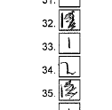
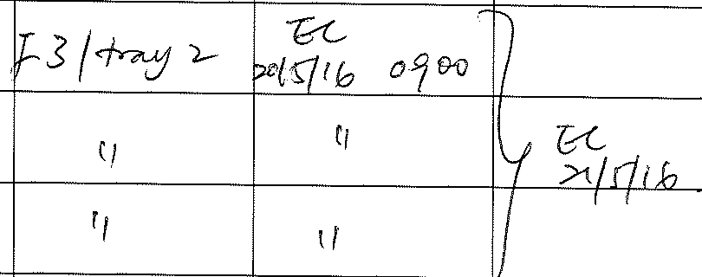
Common monitoring findings
Source data findings
Significant delay in documentation of visit; retrospective entry weeks after visit – NOT CONTEMPORANEOUS.
Unable to determine if clinician making the retrospective entry was at the actual visit.
Blood/urine/ECG results lack of/unclear review by clinicians
Completion of trial or withdrawal process not clearly documented
Entries or amendments non-GCP compliant or unclear
Notes:
Blood/urine/ECG results lack of/unclear review by clinicians
Remind clinicians to review all results and clearly document the review
Any abnormalities and clinical significance
Completion of trial or withdrawal process unclear
Document date of last visit / completion of trial
Ensure to be clear when participant is withdrawn and reason

Slide 33
Common monitoring findings
Informed consent findings
Incorrect versions of PIS/ICF used
Different dates of signing by participant and trial staff
Time of consent not recorded
Statements completed with ticks instead of initials
Amendments on the consent form (e.g. cancelling out of tick and entering initial) not GCP compliant
Not fully completed, statements missed out by participant
Consenter not delegated to consenting task on delegation log
Notes:
Always check for the current version in use before signing.
Have participant complete and sign consent form in the presence of trial staff
Have a check through after participant signs
Ensure instructions given to participant
Have a check through after participant signs
Reminder to give some instructions to participants on how to complete the form, especially optional statements.
Always check through the consent form prior and after signing by participant (version and date of PIS/ICF, participant’s completion, date)
PI’s responsibility to ensure any new staff is appropriately delegated trial tasks before starting any trial activities.

Slide 34
Common monitoring findings
Trial team status:
Staff not on delegation log
Staff carried out activity which (s)he has not been delegated to carry out
Staff dates entered not in chronological order – retrospective entries without comments added
New staff not signed off by CI/PI until weeks/months later
End date not added for staff who has left
Trial specific training not documented
GCP training out of date (according to local policy)
Notes:
Note in the ICH GCP E6 R(2) addendum

Slide 35
Common monitoring findings
Trial files documentation:
The protocol signature date could not be confirmed -- signed in ink by the Chief Investigator but the date was pre-printed and could not be verified as the date of signature.
Documents filed are: incorrect / duplicated / inconsistently filed / in the wrong sections
Documents not filed in a timely manner
About File notes
File notes missing
File notes used inappropriately -- File Notes should be used to provide clarification or signpost to other documents or provide an explanation about something in the trial; File notes should not be used to document protocol related issues.
About emails:
Emails filed with no structure or repeated via email chains
Key emails not filed
Incomplete chain of emails hence unable to explain the issue or topic in full
Notes:
Documents filed are: incorrect (belongs to another trial) / duplicated / inconsistently filed / in the wrong sections
Documents not filed in a timely manner – eg. Past 3 amendments not filed.
Many of these were also examples given at last year’s MHRA symposia

Slide 36
Finally
Thank you for your time
Questions?

